Slide 1
Virtual LANs (VLANs) What are they? How are they configured?

Slide 2
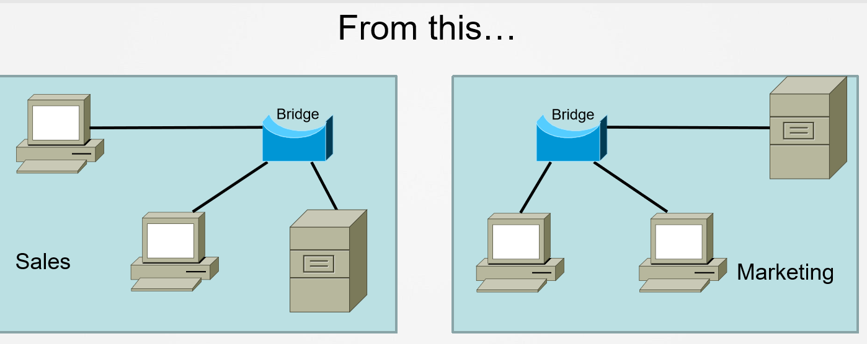
Why VLANs?

Slide 3
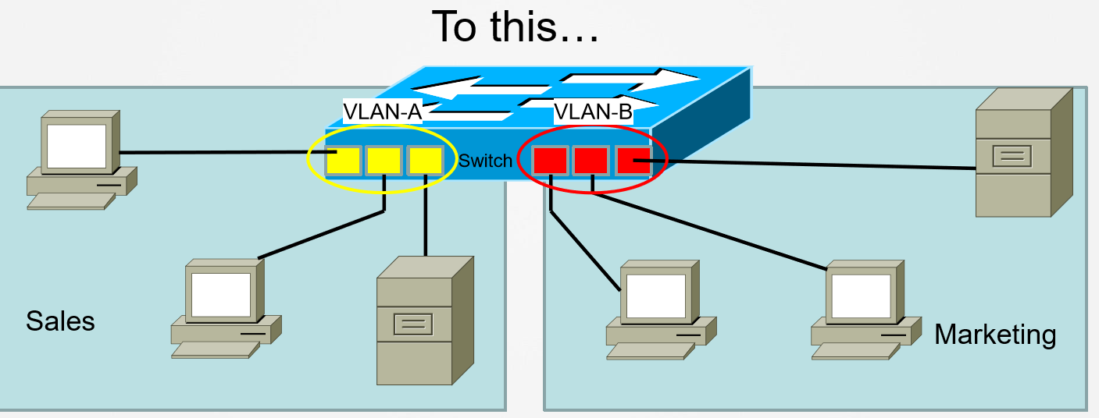
Why VLANs (2)?

Slide 4
Features
» Separates broadcast domain
» Provides better security
» Controls broadcast like ARP
» Provides hierarchical subnet usage

Slide 5
VLAN Ranges
» VLAN range is 1-4094
» 1-1001 are usable normal-range VLANs
» 1002-1005 are reserved for token ring
» 1006-4094 are extended-range VLANs

Slide 6
Configuring VLAN
» Legacy method with VLAN database
• Sw1# vlan database
• Sw1(vlan-database)# vlan <vlan-id>
• Sw1(vlan-database)# end
» Modern method of configuring VLAN
• Sw1(config)# vlan <vlan id>
• Sw1(config-vlan)# name <vlan name>

Slide 7
Configuring Access Ports
» Access Port = Switchport configured for only a single broadcast domain (VLAN).
» Access port configuration
• Switch(config)# interface <interface>
• Switch(config-if)# switchport mode access
• Switch(config-if)# switchport access vlan <vlan-id>

Slide 8
Verifying VLAN
» Verification commands
• Sw1# show vlan <brief>
• Sw1# show interface <type><number> switchport

Slide 9
VLAN Trunks
» Trunk Port
• Can have two or more VLANs configured
• Can carry multiple VLAN information
• By default, all the VLAN traffic is allowed from a trunk port

Slide 10
Trunking Encapsulation
» 802.1Q • Open standard
• All traffic except native VLAN is inserted with a 802.1q tag
• Support concept of native VLAN

Slide 11
Native VLAN
» IEEE 802.1Q supported feature
» Frame without tag is considered native VLAN traffic
» Must match on both ends of the trunk
» By default, native VLAN is 1
» Can be changed using the switchport trunk native vlan <vlan-id> command

Slide 12
Configuring Trunking Encapsulation
» Static trunk configuration
• Switch(config)# interface <interface>
• Switch(config-if)#switchport trunk encapsulation dot1q
• Switch(config-if)#switchport mode trunk
• Switch(config-if)#end

Slide 13
Verifying Trunk
» Verifying VLAN and trunking
• Switch# show vlan <brief>
• Switch# show interface trunk
• show interface status
• show interface <interface> switchport

Slide 14
Dynamic Trunking Protocol (DTP)
» Cisco proprietary feature that allows Cisco switches to negotiate trunk dynamically
» Three modes:
• Auto
• On
• Desirable
» Desirable initiates the trunk, whereas Auto responds only

Slide 15
Implementing DTP
» Configuring DTP
• Switch(config-if)# switchport mode dynamic [desirable|auto]
» Disabling DTP
• Switch(config-if)# switchport nonegotiate

Slide 16
Verifying DTP
» Verification command
• Switch# show interface trunk
• Switch# show interface <interface> switchport

Slide 17
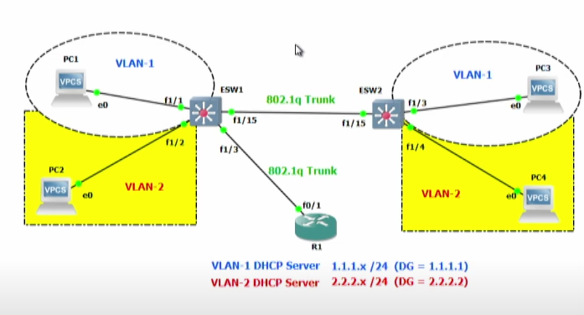
Practical

